Slide 1
Dan Birman
2016-02-16
Frisem

Slide 2
What is it like to be a monkey?

Slide 3
What is it like to be a monkey?
prospective student

Slide 4
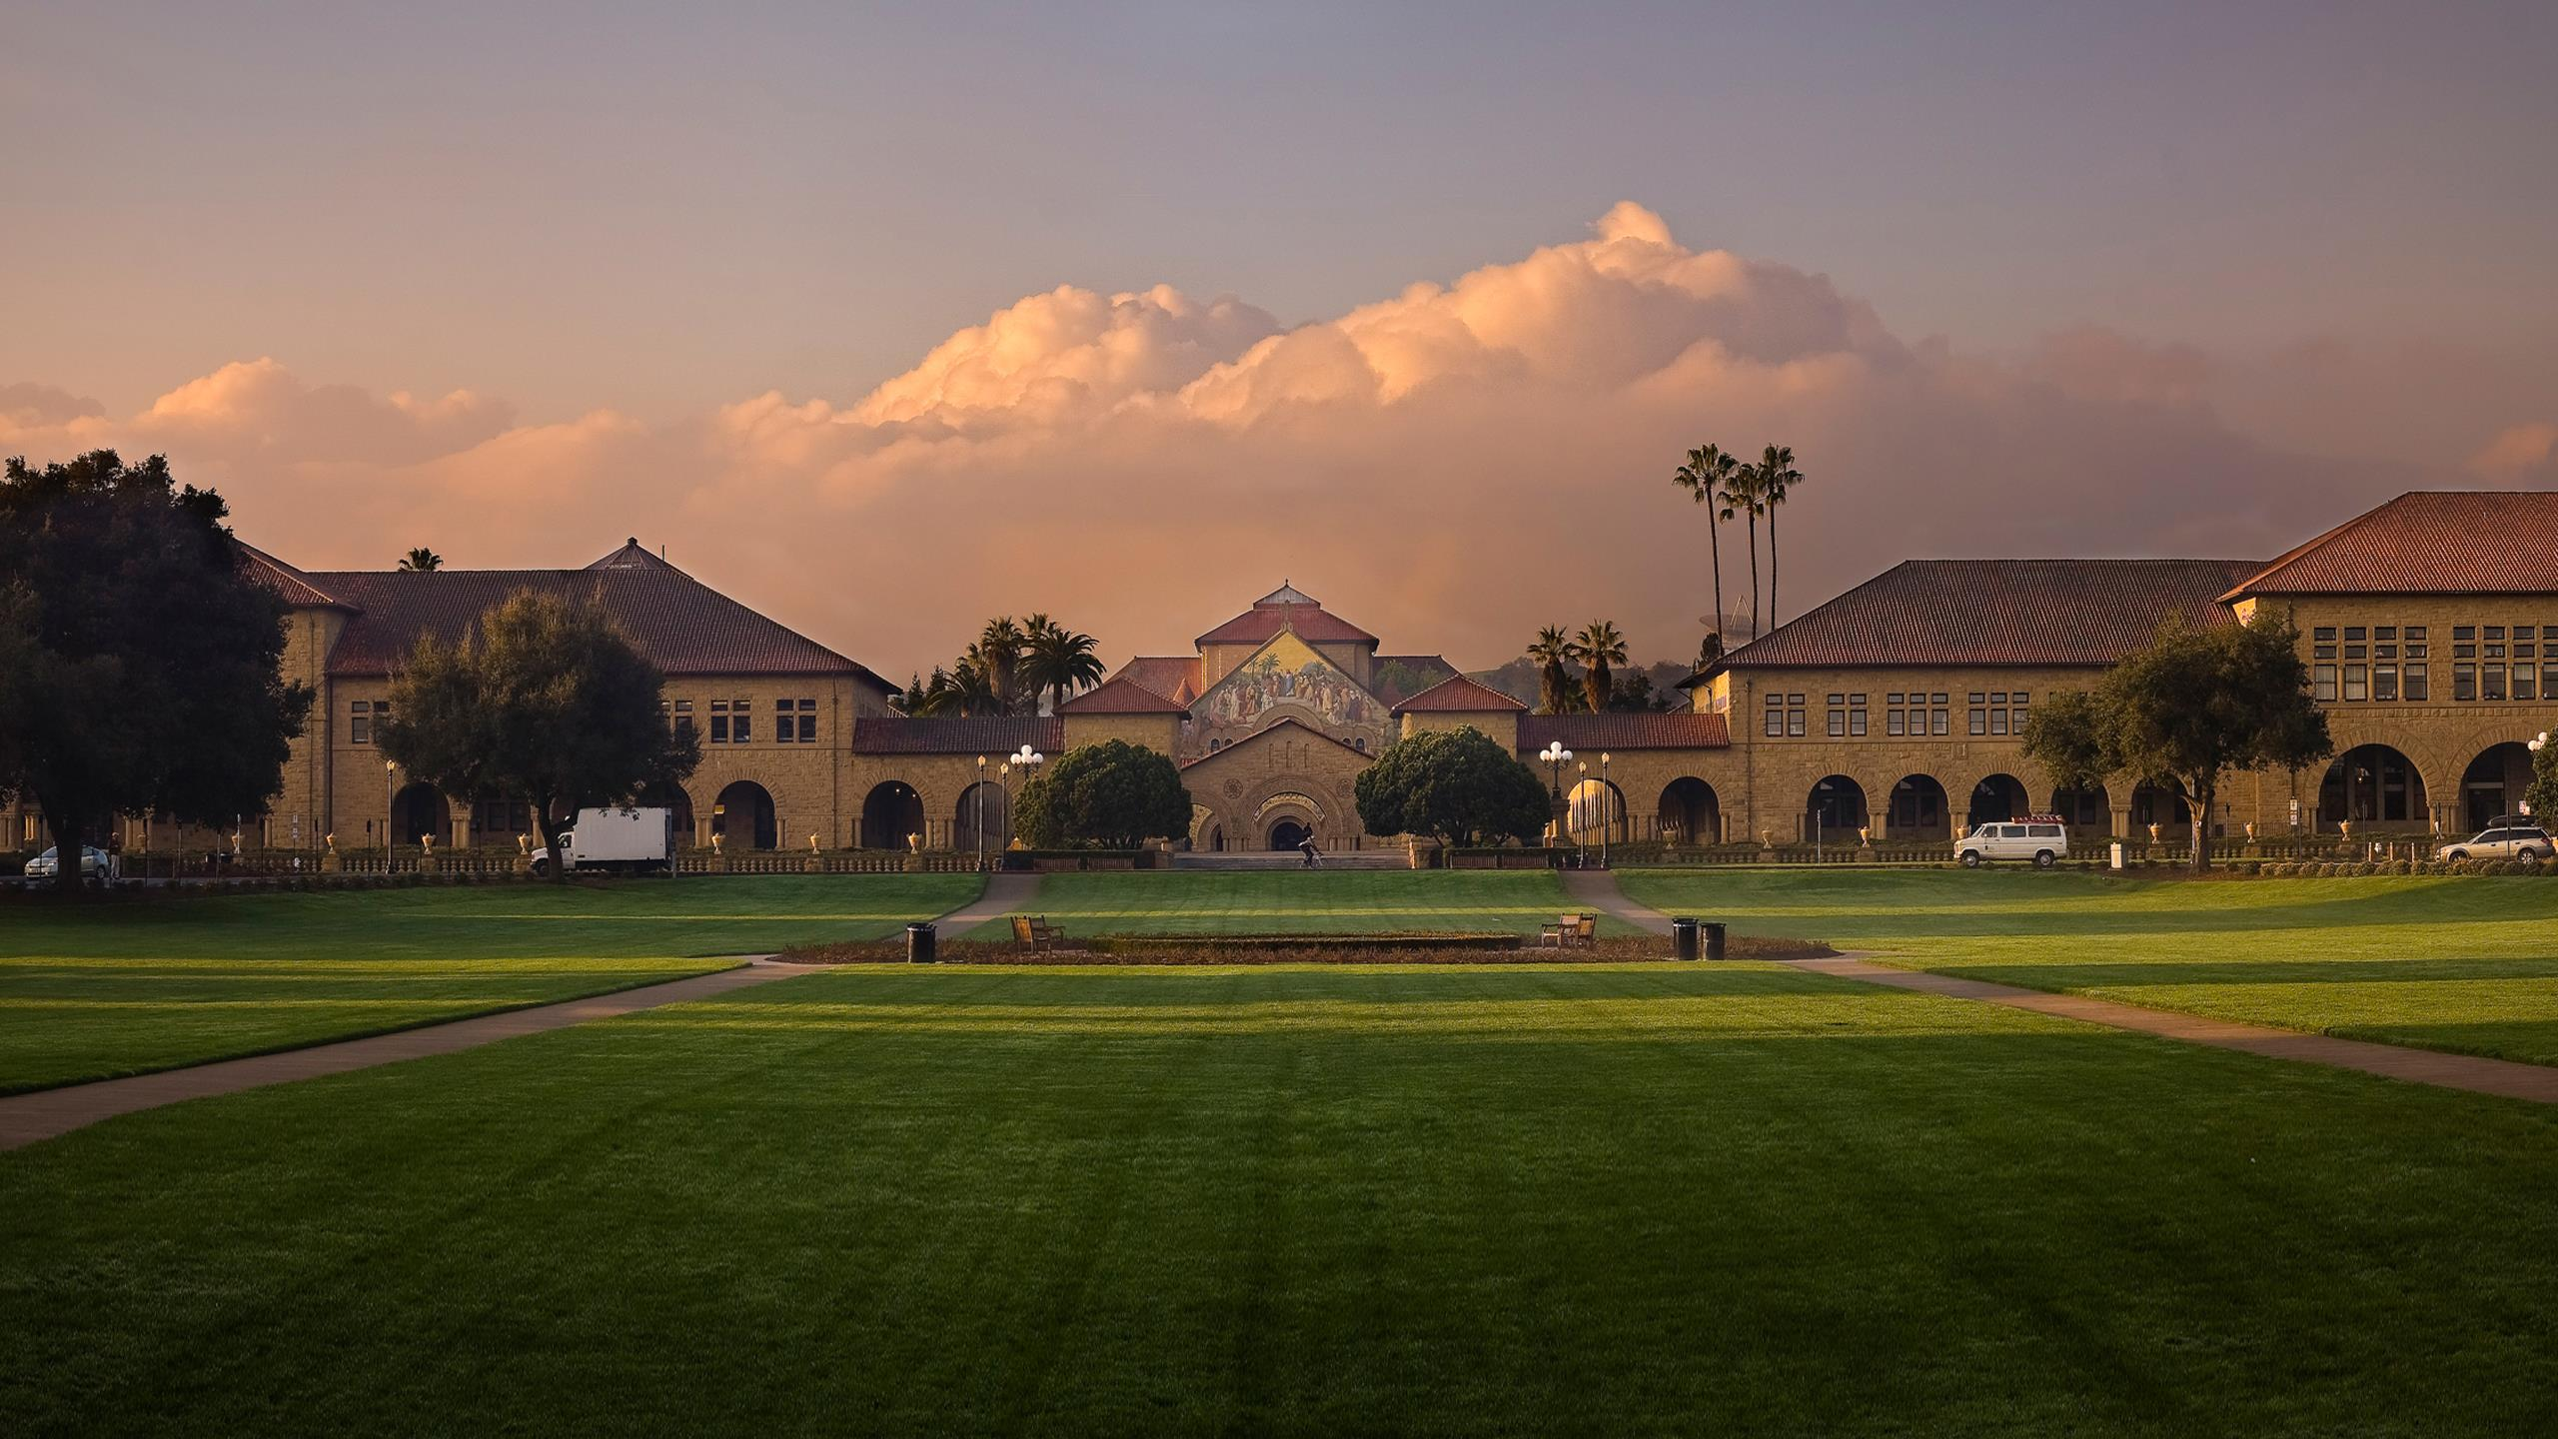

Slide 5
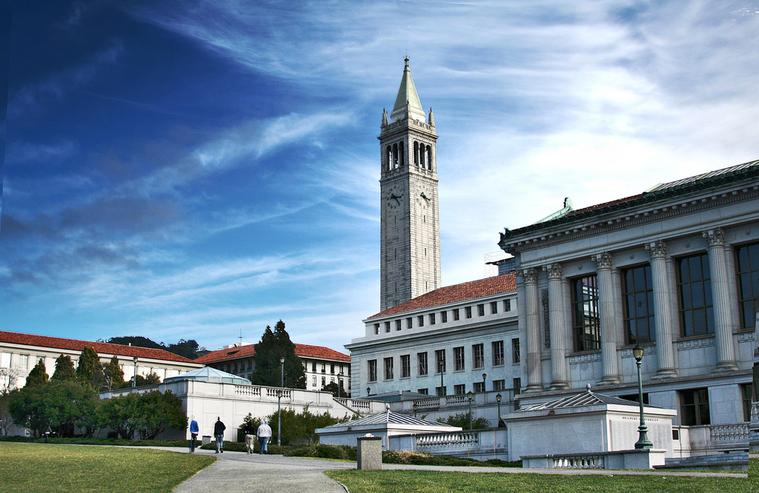

Slide 6


Same?
Different?

Slide 7
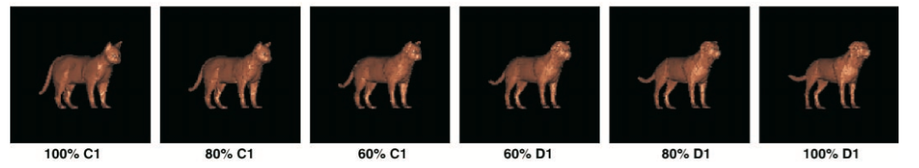
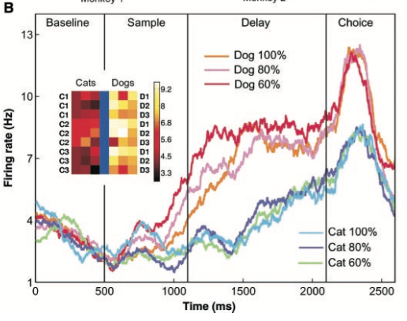
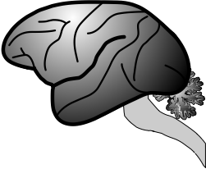
Freedman DJ, Riesenhuber M, Poggio T, Miller EK (2001) Categorical representation of visual stimuli in the primate prefrontal cortex. Science 291:312–316.

Slide 8
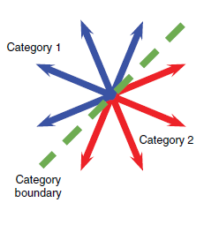
Sarma et al. 2016

Slide 9
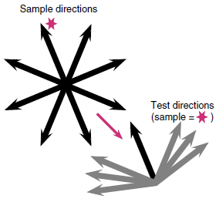
Sarma et al. 2016

Slide 10
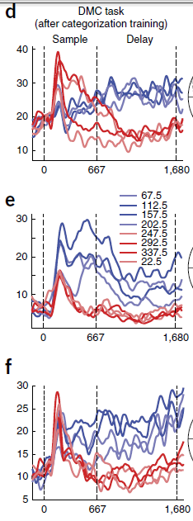

Slide 11
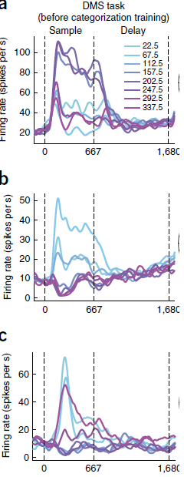

Slide 13
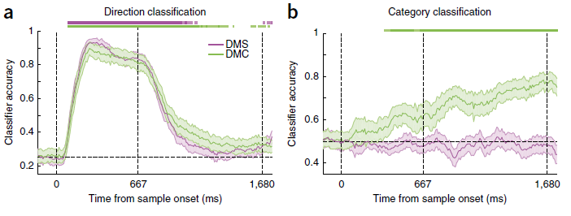

Slide 14
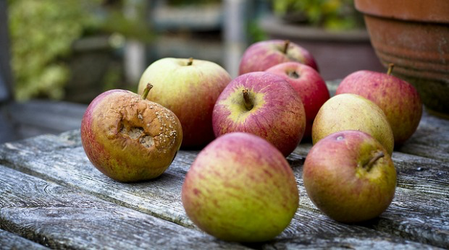
Sarma et al. 2016

Slide 15
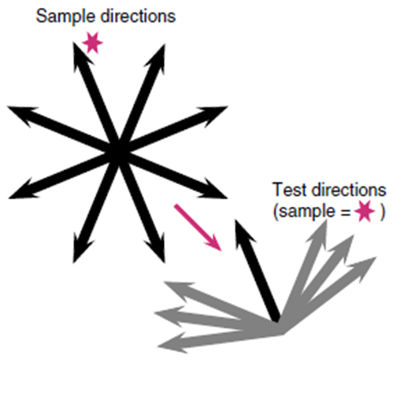


Sarma et al. 2016

Slide 16
So, what is it like to be a
monkey?

Slide 17
So, what is it like to be a
monkey?
human doing the task
the monkeys are doing

Slide 18
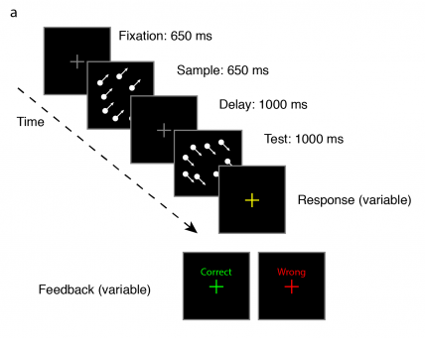
Birman Gardner 2015

Slide 19
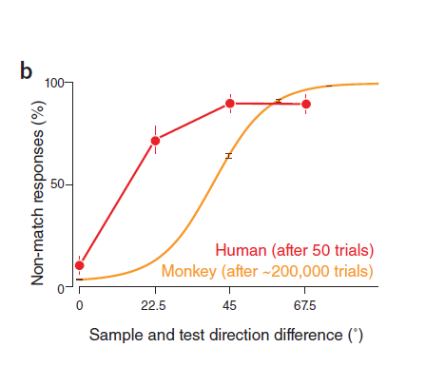
Same
???
60% diff
Different!

Slide 20
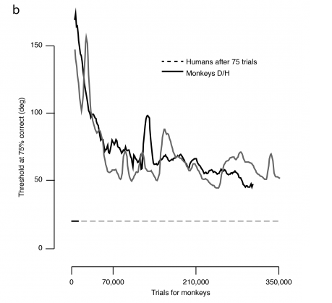

Slide 22
Same
Threshold
60% diff
Different!

Slide 23
Same
Threshold
60% diff
Different!

Slide 24
Same
???
60% diff
Different!

Slide 25



